Slide 1


Slide 2
Present by:
Ankita Jadhav
Shashikant
Chandrakant sahoo
Snigdha jena
Sushma patil
Sharad ahire

Slide 3
Agenda
About the project
About the domain
ETL Process
Data overview
Findings (KPI’S)
Conclusion

Slide 4
About the project
Employee retention refers to the ability of a company to prevent employee turnover.
In other words, it is the company's concerted efforts to retain their existing staff and keep their best employees on board in order to succeed as a business.

Slide 5
About the domain
What is HR Analytics?
HR analytics is the gathering, analyzing and reporting of data that surrounds the management of human resources.

Slide 6
Data overview
Dataset name
HR_1
HR_2
Dataset type
Excel data
Dataset size
50K Records each

Slide 7
ETL PROCESS
Extract
The first stage in which HR dataset was extracted from Excel files, this step involves in reading the data from the source and storing it.
Transform
In this stage, the extracted data is transformed into suitable data types and combining from multiple sources and creating new data fields and removing duplicates and empty data fields.
Load
In this stage the transformed data is loaded into the data warehouse. This step involves creating physical data structures.

Slide 8
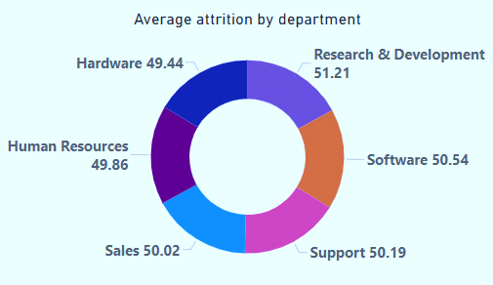
KPI 1.Average Attrition rate for all Departments.
Highest attrition rate is 51.21 which comes from research & development department.
Lowest attrition rate is 49.44 which comes from hardware department.

Slide 9
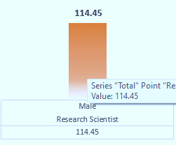
KPI 2. Average Hourly rate of Male Research Scientist.
The male employee working as a research scientist he is earning 114.45 average hourly rate.

Slide 10
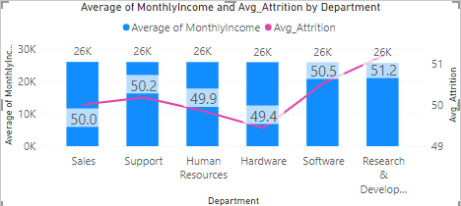
KPI 3. Attrition rate Vs Monthly income stats.
Hardware department is getting highest monthly income where attrition rate is low. That is 49.4
While research and development is getting the lowest monthly income where attrition rate is high. That is 51.2

Slide 11
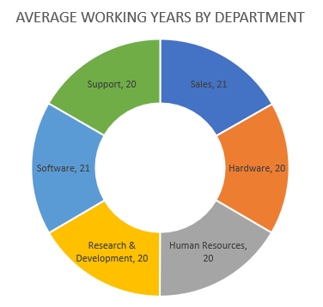
KPI 4. Average working years for each Department.
In the department, sales and software employees have been working for an average of 21 years
In the rest of the departments, the employees have been working for an average of 20 years.

Slide 12
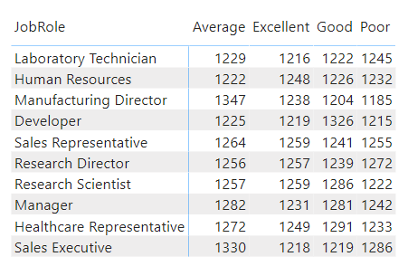
KPI 5. Job Role Vs Work life balance.
Most employees whose job roles are sales representatives and research scientists have excellent work life
Whereas most employees whose job role is sales executive have a poor work life.

Slide 13
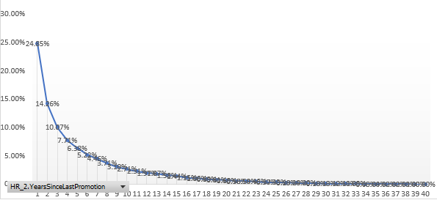
KPI 6. Attrition rate Vs Year since last promotion relation.
Employees who are promoted before 1 year have higher attrition rate. It is 24.05%.
As the promotion period increases, the attrition rate decreases.

Slide 14
CONCLUSION
Employees working in research and development department have low monthly income hence high attrition rate.
Employees who work as research scientists are earning an average of 114.45 per hour and have an excellent work life.

Slide 15
THANK YOU
FOR YOUR ATTENTION

